Slide 1
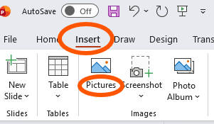
Customizable Flyers for Falls Prevention Events
This file includes a customizable flyer template partners can use to promote a falls prevention event.
How to use this template:
1. The template includes a teal box (see example below) where you can include your organization’s logo, contact information, and/or list services available in your area to help older adults stay falls free.
2. To add text in this box, double click on the box and begin typing.
3. To co-brand this resource with your organization or coalition’s logo, select “Insert” from the ribbon at the top and choose “Pictures” (see image to the right).
4. When your revisions are complete, delete this slide and save the file as a PDF. You can print, post, or distribute your flyer via e-mail.

Slide 2

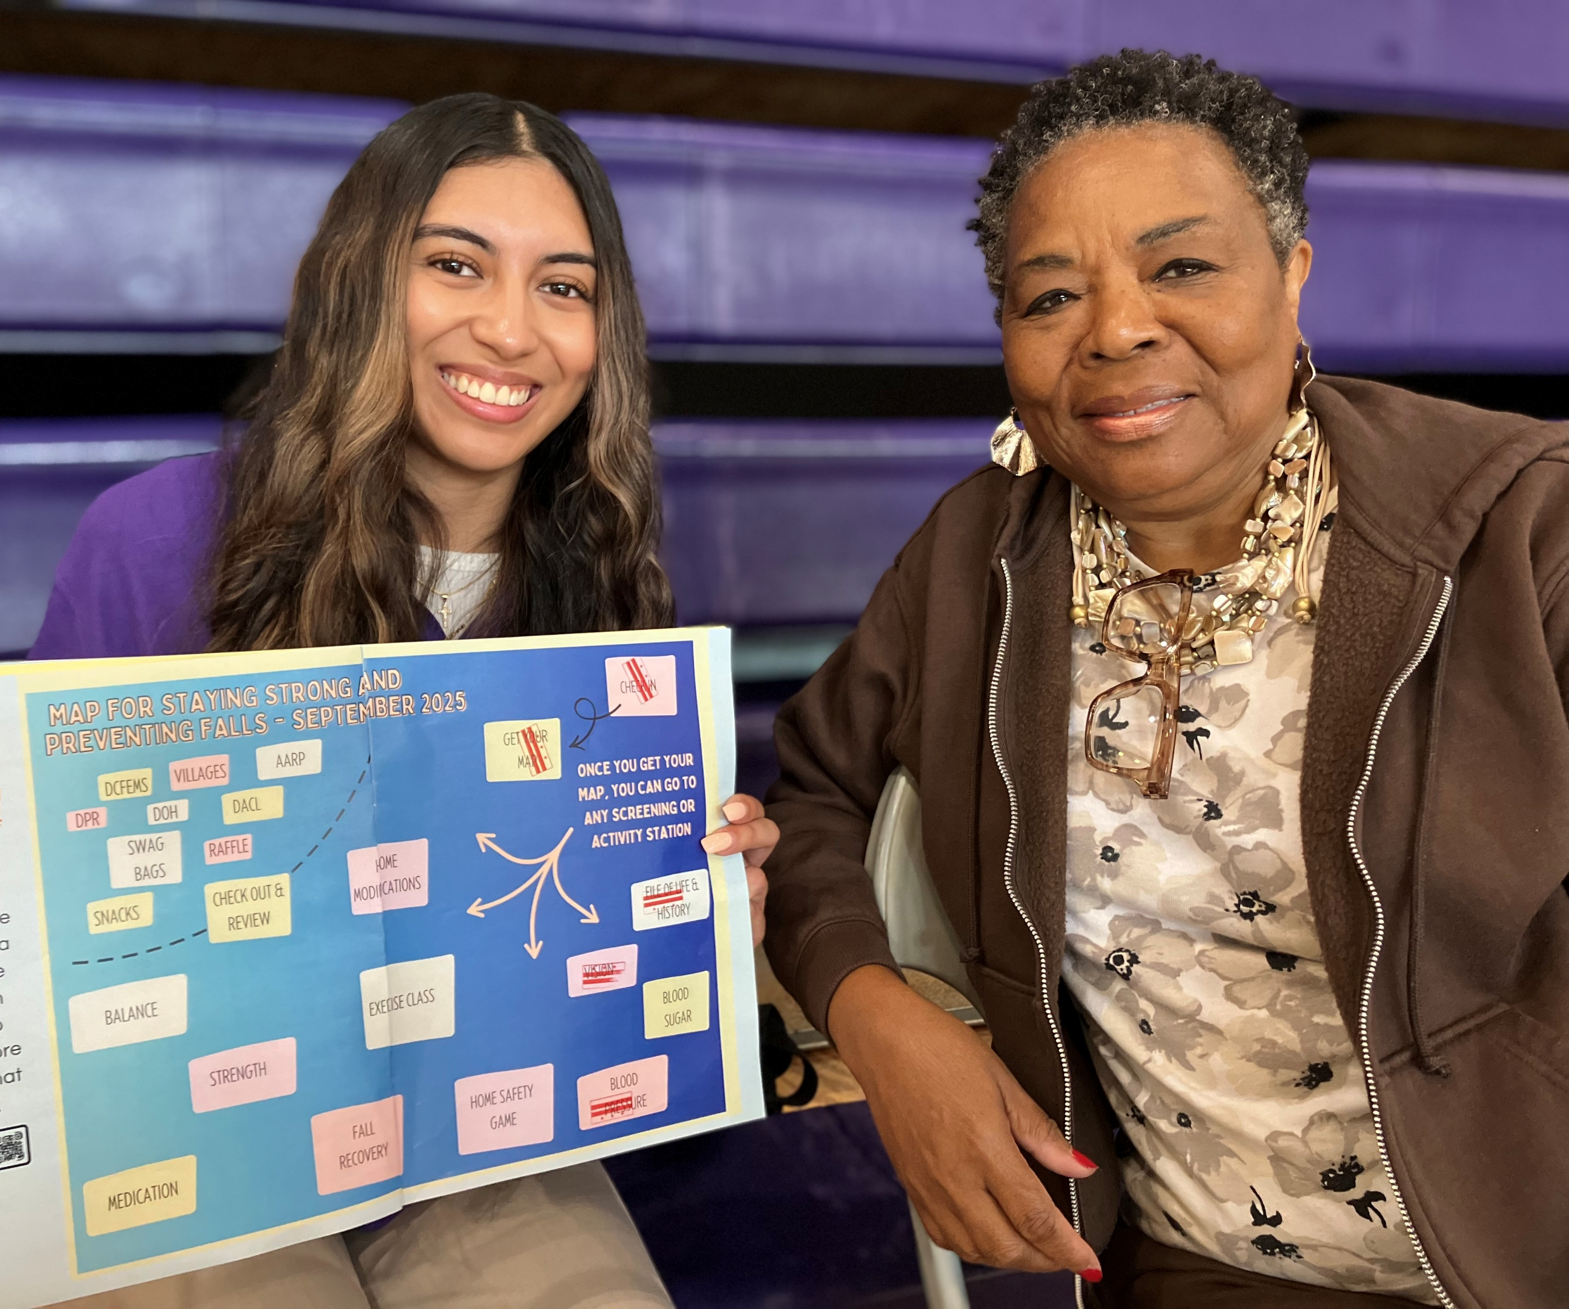
Learn more at ncoa.org/FallsPrevention
Falls are preventable!
Join us to learn more
about strategies that
help us stay safe and independent as we age.
Use this space to add your organization’s logo, contact
information and/or list services available to help older
adults stay falls free.
Tip! Consider adding a QR code for easy registration
NCOA coordinates the Falls FreeⓇ Initiative. NCOA is not a direct sponsor of this event.

