Slide 1
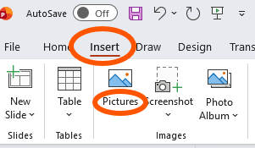
Customizable Flyer for Falls Prevention
This file includes a customizable flyer template partners can use to promote evidence-based falls prevention programs.
How to use this template:
1. The template includes a teal box (see example below) where you can include your organization’s logo, contact information, and/or list services available in your area to help older adults stay falls free.
2. To add text in this box, double click on the box and begin typing.
3. To co-brand this resource with your organization or coalition’s logo, select “Insert” from the ribbon at the top and choose “Pictures” (see image to the right).
4. When your revisions are complete, delete this slide and save the file as a PDF. You can print, post, or distribute your flyer via e-mail.

Slide 2

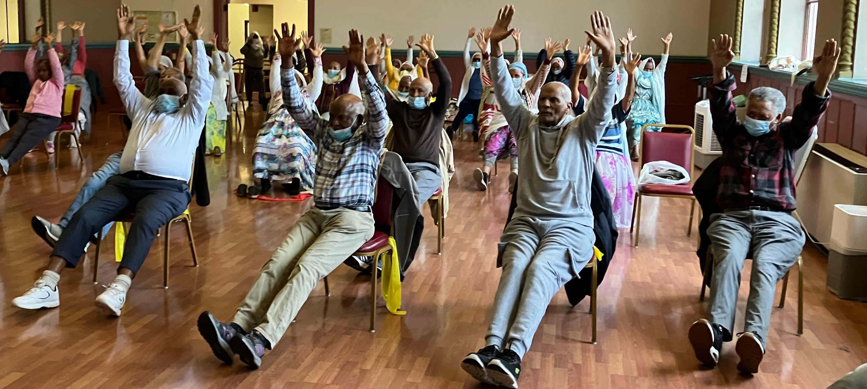
Learn more at ncoa.org/FallsPrevention
Keep moving with confidence!
One proven way to reduce your risk for falls? Improve strength and balance by participating
in an exercise program.
Use this space to add your organization’s logo, contact
information and/or list services available to help older
adults stay falls free.
Tip! Use this space to add information about your next
upcoming evidence-based falls prevention program!
NCOA coordinates the Falls FreeⓇ Initiative. NCOA is not a direct sponsor of this event.

