Slide 1
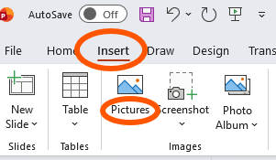
Customizable Flyer for Falls Prevention
This file includes a customizable flyer template partners can use to promote the Falls Free® CheckUp.
How to use this template:
1. The template includes a teal box (see example below) where you can include your organization’s logo, contact information, and/or list services available in your area to help older adults stay falls free.
2. To add text in this box, double click on the box and begin typing.
3. To co-brand this resource with your organization or coalition’s logo, select “Insert” from the ribbon at the top and choose “Pictures” (see image to the right).
4. When your revisions are complete, delete this slide and save the file as a PDF. You can print, post, or distribute your flyer via email.

Slide 2

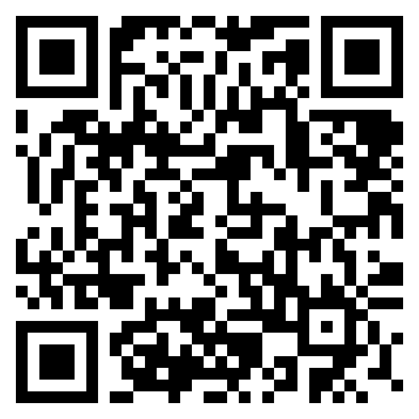
Falls are preventable!
There are simple steps we all can take to reduce our risk of falling.
Ready to get started?
Answer 12 easy questions using NCOA's Falls Free CheckUp® for tips on how to stay active, independent, and falls-free.
Learn more at ncoa.org/FallsPrevention
Scan the QR code using your cell phone camera to get started!
Or go directly to
ncoa.org/FallsFreeCheckUp
Use this space to add your organization’s logo, contact information and/or list services available to help older adults stay falls free.

